Slide 1
BITCOIN PRICE PREDICTION
Obie Udemezue

Slide 2

Table of Contents
01
Purpose
Description, Overview.
02
Data
Collection, Cleaning, Analyze, Visualizing.
03
Model
Facebook Prophet.
04
Vision
Potential, Future Developments

Slide 3
Purpose
Description
Imagine you bought Bitcoin in March 2017 at the price of 1,007 USD and sold it in December the same year at 19,393 USD, how much money could you made? As a ubiquitous investment, Bitcoin has got intense attention from investors and traders.
What if you can capture the trend of Bitcoin price, or more realistic, what if a system could give you advice for how much Bitcoin to sell or buy at a timestamp based on the trend it predicts?
$100.50
$203.00

Slide 4
Purpose
Objective
In order to solve the problem, we produced our project, "Bitcoin Price Prediction".
The project forecasts the value of bitcoin based on its historical price and give users future investment advice!

Slide 5
Data
Collection & Cleaning.
Web Scraping using bitcoin API to fetch time series data
The first step is to collect data and preprocess it.
We use a bitcoin API from Binance.com to fetch time series data, then filter and transform it to the correct format.
Filter data to get the features needed
Change data format to feed model

Slide 6

Data
Visualize
We visualize our data with the help of inbuilt functions which helps us gain insights and analyze the trends in the data.
From the insights obtained we can infer that Bitcoin is very volatile and fluctuates quite a bit. This indicates that it is not going to be an easy task to predict the price of it.

Slide 7
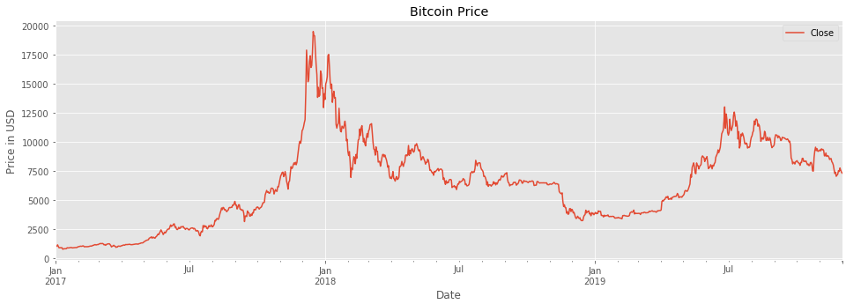
Data
Insights/Trends

Slide 8
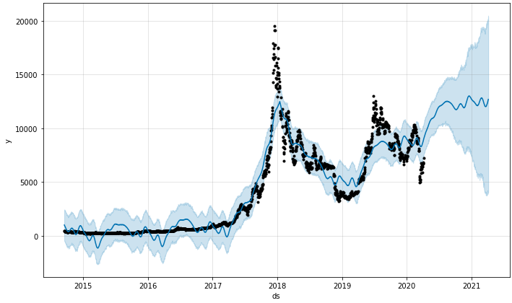
Model
Facebook Prophet
Prophet is a procedure for forecasting time series data based on an additive model where non-linear trends are fit with yearly, weekly, and daily seasonality, plus holiday effects.
It works best with time series that have strong seasonal effects and several seasons of historical data.
Prophet is robust to missing data and shifts in the trend, and typically handles outliers well.

Slide 9
Model
Constraints
It is solely analytically based, using trends and patterns to determine the future.
The acceptance of Bitcoin is lower than the real currency, and less business transaction records are provided.
The time series data is just from open source which lasted for a fixed period.

Slide 10
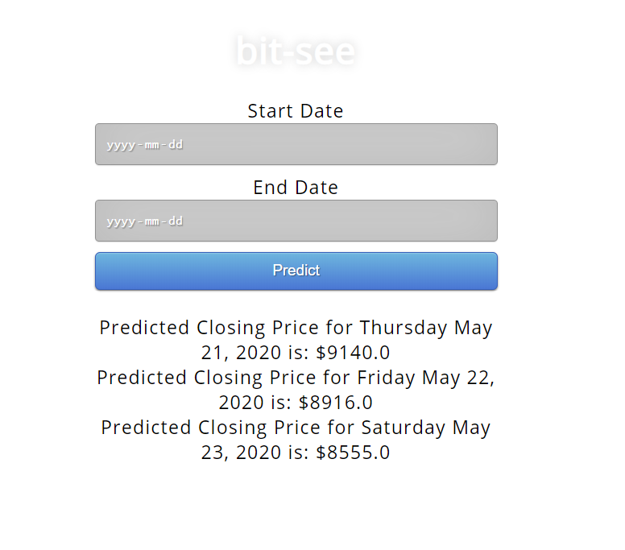
User Interface
https://bytgypsy-app.herokuapp.com

Slide 11
Vision
Future Developments
Demand and supply of Bitcoin
Cost of mining a Bitcoin
Number of competing currencies
Exchanges it trades on
Regulations governing its sale
Media influence

Slide 12
Vision
We don't want to sell you Bitcoin, we want to sell you an idea.
Building trust between the customer and us based on how well our model performs on a volatile commodity such as Bitcoin.

Slide 13
Thank you!

